Slide 1
Module 2
Namespaces

Slide 2


Module Overview
In this module, you will learn about:
XML Namespaces
Working with Namespaces Syntax

Slide 3


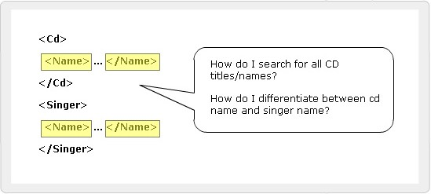
Duplicate Element Names
XML allows developers to create their own elements and attributes for their own projects.
Developer has to ensure the uniqueness of the element names and attributes in a document.
Name conflicts are inevitable from different developers.
It is difficult for the browser to distinguish a conflicting element.

Slide 4
Namespaces
Elements are distinguished by using namespaces.
A namespace is a collection of names, allows the browser to:
Combine documents from different sources
Identify the source of elements or attributes

Slide 5
Prefixing element names
Prefixes in element names provide a means to
prevent name collisions.
Code Snippet
<CD:Title> Feel </CD:Title>
and
<Book:Title> Returning to Earth </Book:Title>.
In the above example, both CD and Book are namespace prefixes.

Slide 6


Problems Posed by Prefixes
Duplication would still exist if prefixes are not unique
To solve this problem, each namespace prefix is added to a Uniform Resource Identifier (URI)
Code Snippet
<S:Student xmlns:S=” http://www.spectrafocus.com
/student/”>
<S:First>John</S:First>
<S:Last>Dewey</S:Last>
<S:Title>Student</S:Title>
</S:Student>

Slide 7
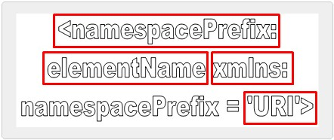
Namespace Syntax 1-2
Code Snippet
<Auc:Books xmlns:Auc=”http://www.auction.com/books” xmlns:B=”http://www.books.com/HTML/1998/xml1”>
...
<Auc:BookReview>
<B:Table>
...

Slide 8

Namespace Syntax 2-2
NamespacePrefix
Used as a reference to the namespace
Prefixes must not begin with xmlns or xml
ElementName
Specifies the name of the element
xmlns
xmlns stands for XML namespace
URI
URI is a string of characters which identifies an Internet Resource

Slide 9
Placing attributes in a Namespace
Attributes belong to particular elements
They are not a part of namespace, even if the element is within some namespace
If an attribute has no prefix, it has no namespace
An attribute without a prefix is in default namespace
Syntax
<Catalog xmlns:Book = “http://www.aptechworldwide.com”>
<Book:Booklist>
<Book:Title Book:Type = “Fiction”>Evening in Paris</Book:Title>
<Book:Price>$123</Book:Price>
</Book:Booklist>
</Catalog>

Slide 10


Default Namespaces 1-2
mathematical expressions
Comes in two types:
As a markup language for presenting the layout of mathematical
expressions
As a markup language for presenting the mathematical content of the formula
MathML Document
XML-based markup
language to represent complex
Code Snippet
<MRow>
<Mi>x</Mi>
<Mo>+</Mo>
<Mn>1</Mn>
</MRow>

Slide 11

Default Namespaces 2-2
Syntax
<elementName xmlns=’URL’>
where,
elementName specifies the name of the element belonging to the same
namespace
URL specifies the namespace which is reference for a document or an HTML
page on the Web
Code Snippet
<Catalog xmlns:Book = “http://www.aptechworldwide.com”>
<Book:Booklist>
<Book:Title Book:Type = “Fiction”>Evening in
Paris</Book:Title>
<Book:Price>$123</Book:Price>
</Book:Booklist>
</Catalog>
A default namespace using the xmlns attribute with a URI as its value

Slide 12


Override Default Namespaces 1-2
Default namespace applies to the element on which it
was defined and all descendants of that element
New namespace definition overrides the previous one and becomes the default for that element

Slide 13
Override Default Namespaces 2-2
Code Snippet
<Catalog xmlns = “http://www.aptechworldwide.com”>
<Book>
<Title type = “Fiction”>Evening in Paris</Title>
<Price>$123</Price>
</Book>
<Book>
<Title type = “Non-Fiction”>Return to Earth</Title>
<Price xmlns = “http://www.aptech.ac.in”>$23</Price>
<Title type = “Non-Fiction”>Journey to the center of the Moon</Title>
<Price>$123</Price>
</Book>
</Catalog>
This namespace of price element applies only to it and overrides the namespace in the catalog element

Slide 14
Summary
XML Namespaces
Namespaces distinguish between elements and attributes with the same name from different XML applications.
It is a collection of names that can be used as element names or attribute names in XML document.
XML namespaces provide a globally unique name for a element or attribute to avoid name collisions.
Working with Namespaces syntax
Namespaces are declared by an xmlns attribute whose
value is the URI of the namespace.
If an attribute name has no prefix, it has no namespace.
A default namespace is used by an element and its child elements if the element does not have a namespace prefix.

